Slide 1
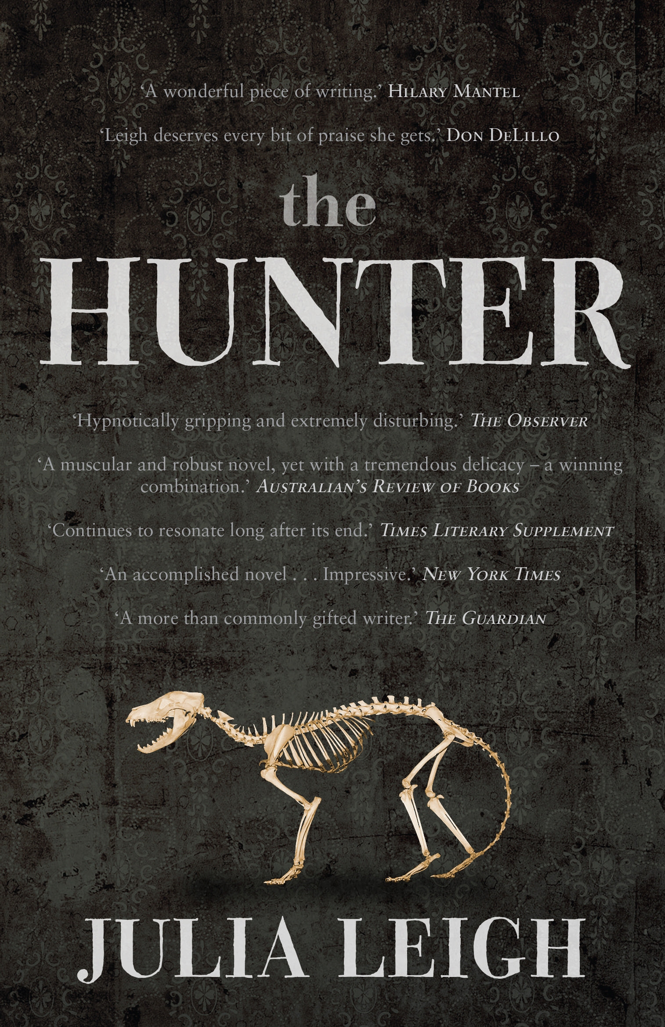
What is an environmental text?
Dr Tony Hughes-d’Aeth
Senior Lecturer
English and Cultural Studies
The University of Western Australia

Slide 2
The novel
“M” (aka. Martin David) has been tasked by a biotechnology company to acquire the ova and reproductive organs of a Thylacine (Tasmanian Tiger)
We never find out what they need this for
He doesn’t know and doesn’t care
Posing as a naturalist, M undertakes a series of lone expeditions into the remote alpine wilderness of Tasmania, searching for his prey
In between he stays with a woman and her two young children
Their father, a conservationist, has disappeared and is presumed dead

Slide 3
ending
M befriends the family—Lucy, Sass and Bike—and the expectation grows that he might replace their father (Jarrah Armstrong)
But he does not
He returns from time away to find that the family has been destroyed by fire
Lucy is severely injured and the children have been placed in foster care
M is reabsorbed into his functional role and completes the mission, calmly trapping and killing the female tiger and removing her eggs and ovaries.

Slide 4
Why study the novel?
Quite teachable
Short (170 pages) but the situations in the novel are well poised
The novel resists immediate interpretation
Promotes interpretive debate
Sends students / classes back to passages in the book to find exact phrasings and words
Practice forensic usage of the text
The text as evidence

Slide 5
An environmental novel
It is a useful—although not exactly “classic”—example of an environmental novel
But first, what is an environmental novel?
Or, more generally, what is an environmental text?
Fortunately for us, someone has not only posed this question but provided a lucid and influential answer …

Slide 6
Lawrence Buell
The Environmental Imagination (1995)
Thoreau, Nature Writing and the Formation of American Culture
“What Is an Environmental Text?” (pp.6-8)
The nonhuman environment is present not merely as a framing device but as a presence that begins to suggest that human history is implicated in natural history
The human interest is not understood to be the only legitimate interest
Human accountability to the environment is part of the text’s ethical orientation
Some sense of the environment as a process rather than as a constant or a given is at least implicit in the text

Slide 7
Environmental ethics
“What Is an Environmental Text?” (pp.6-8)
The nonhuman environment is present not merely as a framing device but as a presence that begins to suggest that human history is implicated in natural history
The human interest is not understood to be the only legitimate interest
Human accountability to the environment is part of the text’s ethical orientation
Some sense of the environment as a process rather than as a constant or a given is at least implicit in the text

Slide 8
ecocentrism
“What Is an Environmental Text?” (pp.6-8)
The nonhuman environment is present not merely as a framing device but as a presence that begins to suggest that human history is implicated in natural history
The human interest is not understood to be the only legitimate interest
Human accountability to the environment is part of the text’s ethical orientation
Some sense of the environment as a process rather than as a constant or a given is at least implicit in the text

Slide 9
So, is The Hunter an environmental text??
I’m not sure …
That’s a good thing!
Students seem to hate it when you know the answer and you are just making them guess at it until they hit the target
But let’s go through the Buell test

Slide 10
The “Buell” test
human history implicated in natural history?
human interest not the only interest?
human accountability to the environment?
environment understood as process?

Slide 11
1) human history implicated in natural history?
Not exactly, the narrative submits the natural world—with the thylacine as its evocative emblem—to human instrumentalism
i.e. M succeeds and the last Thylacine is sacrificed for human-centred biotechnology
But, the chilling and violent quality of this victory also implies a critique
A cautionary tale

Slide 12
2) human interest not the only interest
Yes I think it passes this measure. One comes to feel a desperate identification with the Thylacine.
One wishes deeply that it will survive
“Its” interest seems to be the paramount one for us
Although, we should also ask why?
Why do we identify with an extinct animal?

Slide 13
3) Human accountability to environment
Again the novel is usefully ambiguous on this point
The environmentalists are satirised as ineffectual hippies or brain-dead stoners
Jarrah Armstrong is introduced as an idealised naturalist
But he is dead
And in his place is M
And M wins
But also, it is an “empty” victory

Slide 14
4) environment understood as process
Buell seems to have two things in mind here:
Environment is a complex system that proceeds according to its own interrelated patterns – i.e. the “eco-system”
The environment is fragile and its complex balances can be interrupted by human action
In The Hunter, we do experience the environment as an “other”
The wilderness seems fundamentally inhuman
It is not a romantic nature
M is understood, in some ways, as “natural” in the sense that he is a being reduced to pure drive
He acts without remorse according to the dictates of his mission

Slide 15
So … yes or no???
I think it is an environmental text
Even though it doesn’t exactly fit the criteria set down by Buell
The important thing, though, is …
What do you think?
What do your students think?
And why.

Slide 16
References
Lawrence Buell, The Environmental Imagination: Thoreau, Nature Writing and the Formation of American Culture. Cambridge, Massachusetts: Harvard UP, 1995.
Greg Garrard, Ecocriticism. London and New York: Routledge, 2012. (part of the Routledge “New Critical Idiom” Series)
Tony Hughes-d’Aeth, “Australian Writing, Deep Ecology and Julia Leigh’s The Hunter” JASAL (Journal of the Association for the Study of Australian Literature) 2.1 (2002) 19-31.
  http://www.nla.gov.au/ojs/index.php/jasal/article/viewFile/14/12

