Slide 1
Poetry in the Classroom
Lucy Dougan and Claire Jones

Slide 2
Young writer as observer
We are all strange planets with our own histories and peculiarities. Whether we approach creative texts as readers or creators, hopefully the immersion involved allows us to discover and express the particular/ the peculiar.
Writing, in Michael Ondaatje’s words, is “picking up the pins”. Take time to encourage your class to become observers – as both close readers and writers – so that you get a whole practice going.
Encourage: journal keeping, notebooks, scrapbooks, ‘sketching’, collections (virtual as in pinterest or real), walks (even or especially to an under-used part of your own school grounds), whole class activities such as researching your gran’s wedding dress. Encourage specificity of detail in their writing and also research – whether that is personal ‘field work’ or perhaps using a specialist dictionary (eg the old terms for cloth).

Slide 3
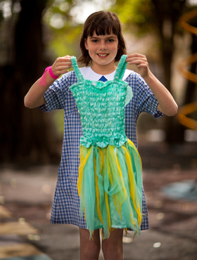

Observational Practice
The Poetry Object Reading Resource

Slide 4
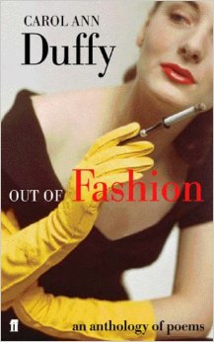
Out of Fashion
(ed. Carol Ann Duffy)
Twice
Long Boots
The Sari
Red Gloves
Grave Goods
http://www.faber.co.uk/9780571219940-out-of-fashion.html

Slide 5
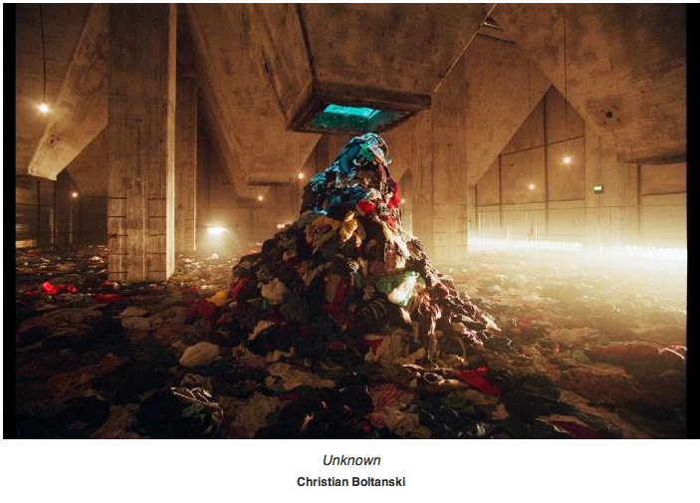
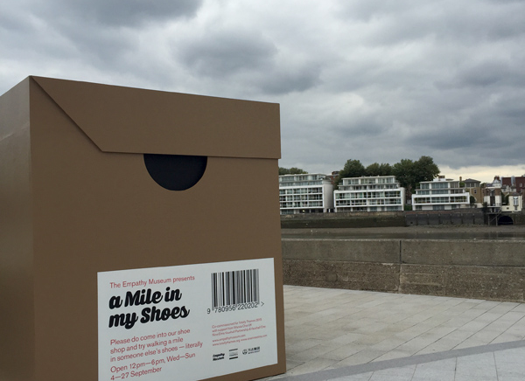
Classroom Ideas
Button jar
Clothes box
Shoes
Christian Boltanski
http://www.artdiscover.com/en/artists/christian-boltanski-id53
A Mile in My Shoes
http://totallythames.org/events/info/a-mile-in-my-shoes

Slide 6
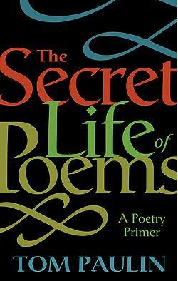
Teaching close reading
Review from The Guardian
Review from The Time Higher Educational Supplement

Slide 7
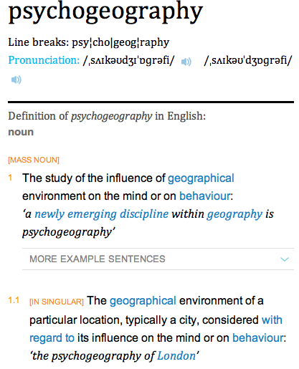
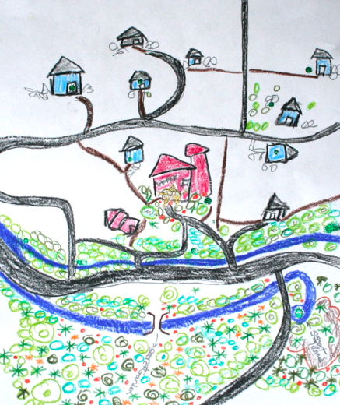
Considering psychogeography
Tate Modern Glossary

Slide 8
London
By William Blake
I wander thro' each charter'd street,
Near where the charter'd Thames does flow.
And mark in every face I meet
Marks of weakness, marks of woe.
In every cry of every Man,
In every Infants cry of fear,
In every voice: in every ban,
The mind-forg'd manacles I hear
How the Chimney-sweepers cry
Every blackning Church appalls,
And the hapless Soldiers sigh
Runs in blood down Palace walls
But most thro' midnight streets I hear
How the youthful Harlots curse
Blasts the new-born Infants tear
And blights with plagues the Marriage hearse

Slide 9
Blake and London: Psychogeography
Will Self, Ian Sinclair, Aidan Andrew Dunn, Merlin Coverley
Walking Blake’s London
Reading Kings Cross

Slide 10
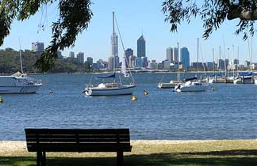
Reading Western Australian locations
Winton, Stow, Hewett, Drewe, Jones, Whish-Wilson, Scott, Curtin, etc.
Perth, Albany, Wheatbelt, Goldfields, Geraldton, Broome, Kimberley, etc.

Slide 11
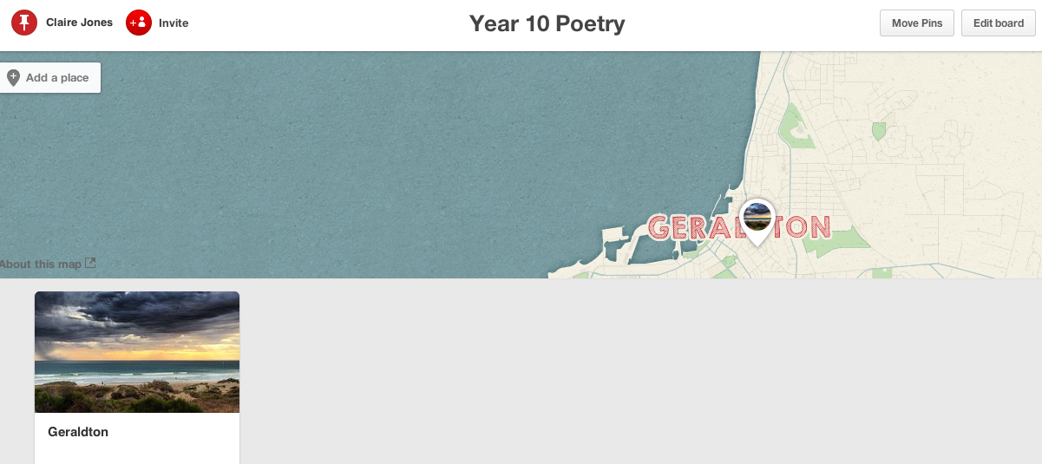
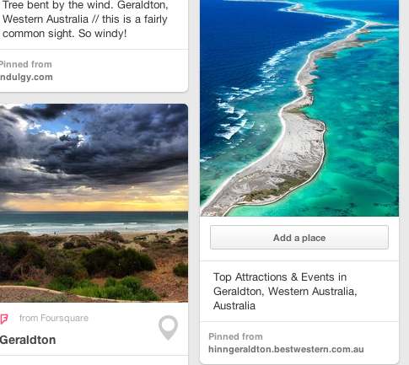
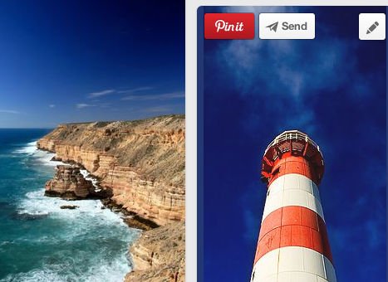
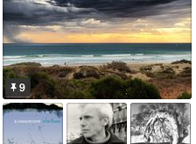
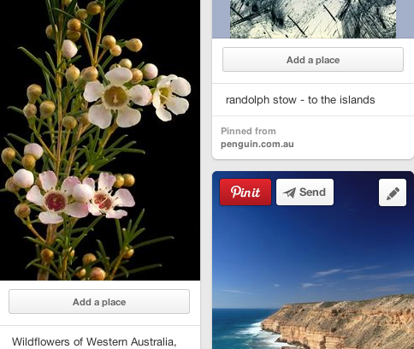
Geraldton, WA.

